Slide 1


Weekly Report NTUA 8/5/2020
George Bakas

Slide 2
Status Report
Analysis:
Noticed that in our training we are not selecting events that pass a mass cut
(50, 300) GeV
Implemented and re-training
Production with new files to check whether CR has no ttbar contamination
LHCtopWG
Working on the presentation for TOP-18—013
https://indico.cern.ch/event/888620/timetable/

Slide 3
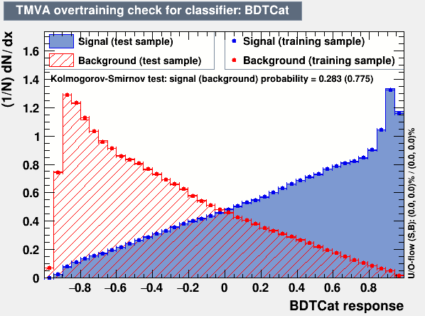
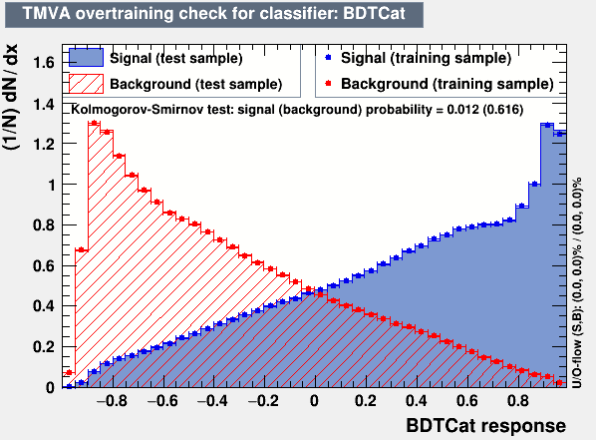
New training with mass cut: 50 < m_{top} <300 GeV
With mass cut
Without mass cut
Waiting for production so that we can check whether the ttbar contamination in the CR is maybe a consequence of our training…

